Slide 1
Discussion 05
Spring 2019 – CS 188
Section 2B

Slide 2
Paxos
Key idea: apply update only if majority of replicas commit to it
If 2f + 1 replicas, we need f+1 to commit
Tolerate more failures à have more replicas
Three conceptual roles
Proposers propose values
Acceptors accept values; chosen if majority accept
Learners learn the outcome (chosen value)

Slide 3
Overview
Three phases in each round
Prepare Phase
Proposer sends a unique proposal number to all acceptors
Waits to get commitment from majority of acceptors
Accept Phase
Proposer sends proposed value to all acceptors
Waits to get proposal accepted by majority
Learn Phase
Learners discover value accepted by majority

Slide 4
Example 1:
•Acceptor1: P1 A1-v1 P2 A2-v1
•Acceptor2: P1 A1-v1 P2 A2-v1
•Acceptor3: P1 A1-v1
Notes:
P1 == <Prepare, 1>
A1-X == <Accept, (1, X)>

Slide 5
Example 2:
Acceptor1: P1 A1-v1
Acceptor2: P1 P2 A1-v1 A2-v2
Acceptor3: P2 P3 A2-v2

Slide 6
Example 3:
Acceptor1: P1 A1-v1
Acceptor2: P1 P2 A2-v2
Acceptor3: P2 A2-v2
What happens if there is network delay for accepter2 and proposer 1?

Slide 7
Example 3:
Acceptor1: P1 A1-v1 P3 A3-v2
Acceptor2: P1 P2 A2-v2 A1-v1 P3 A3-v2
Acceptor3: P2 A2-v2
Notes:
Proposer1 reenters the prepare phase with a higher proposal number.

Slide 8
Example 4: Learn phase - Proposer broadcasts
•Acceptor1: P1 A1-v1
•Acceptor2: P1 A1-v1
•Acceptor3: P1 A1-v1
Proposer1
Leaner1

Slide 9
Example 5: Learn phase - Acceptor broadcasts
•Acceptor1: P1 A1-v1
•Acceptor2: P1 A1-v1
•Acceptor3: P1 A1-v1
Leaner1
Notes:
P1 == <Prepare, 1>
A1-X == <Accept, (1, X)>

Slide 10
Example 6: Learn phase - Mimic proposers
•Acceptor1: P1 A1-v1 P2 A2-v1
•Acceptor2: P1 A1-v1 P2 A2-v1
•Acceptor3: P1 A1-v1
Leaner1
Notes:
P1 == <Prepare, 1>
A1-X == <Accept, (1, X)>

Slide 11
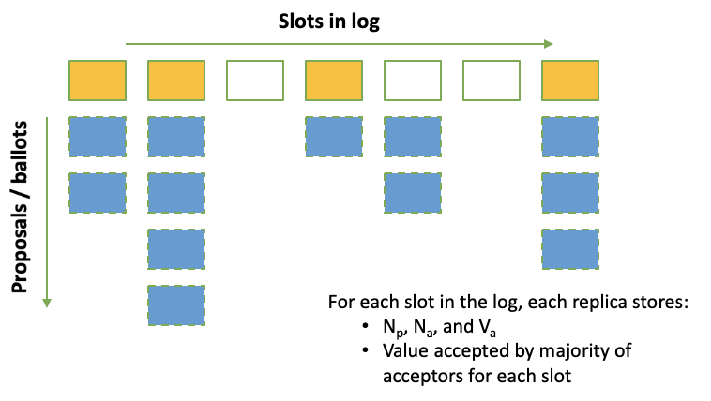
RSM with Paxos

